Slide 1
Fresh Grads – Group Project
Online Ayurveda Medicine Order App

Slide 2
Problem Statement
To Create an Application for Online Ayurveda Medicine
Customer should be able to search,buy, modify and order the medicine.
Admin should be able to perform below operations:
1.Customer Management
2.Medicine Management
3.Order Management

Slide 3
Road Map
Application will be developed in following Sprints –
Core Java +JPA with Hibernate
Spring Boot + Rest Controller + JPA with Hibernate
Angular for UI design (Front End) + Integration with previous Sprint

Slide 4
Plan
Design
    Generate the skeleton as per class design provided
TDD approach
    Identify test cases for each module
    Write Failing Test cases
    Convert the Test Cases in GREEN
Implement the case study in incremental manner

Slide 5
Modules
Login Module
Customer Module
Medicine Module
Order Module

Slide 6
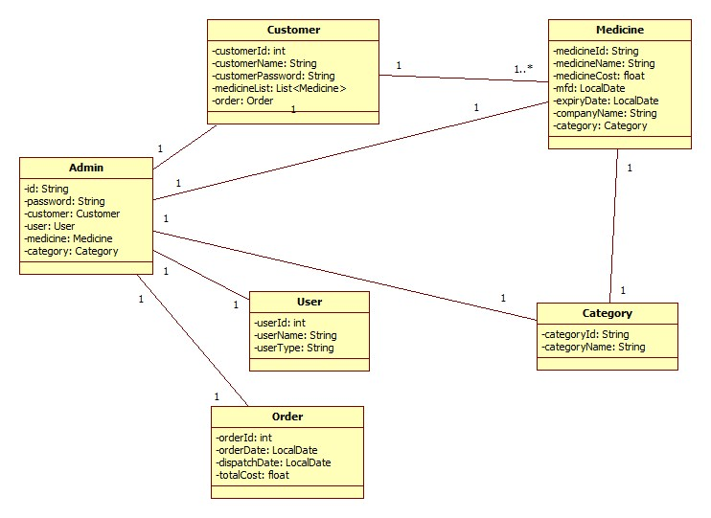
Class Design
POJO Classes:

Slide 7
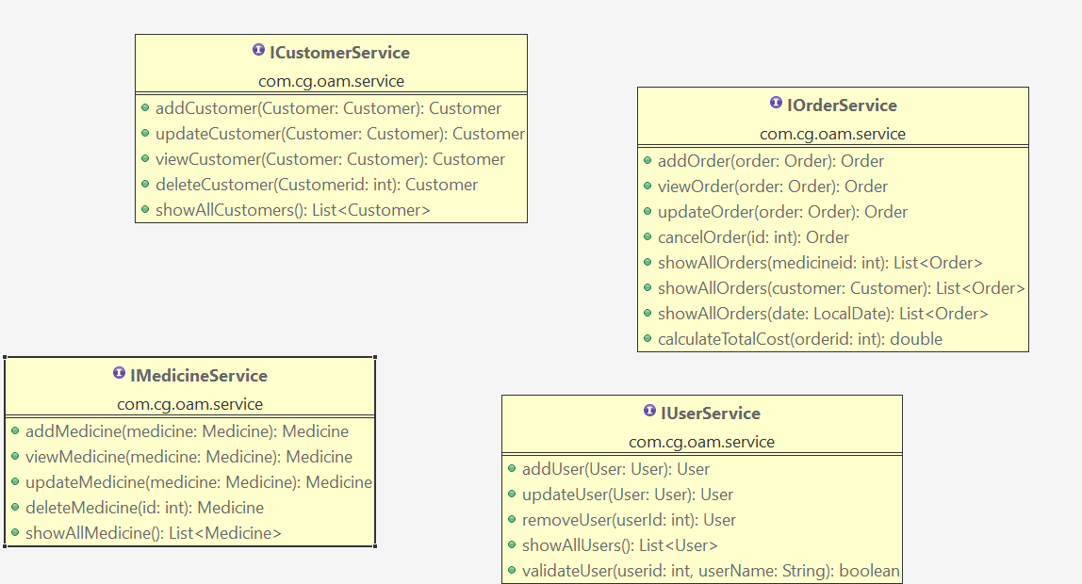
Class Design
Service Interface:

Slide 8
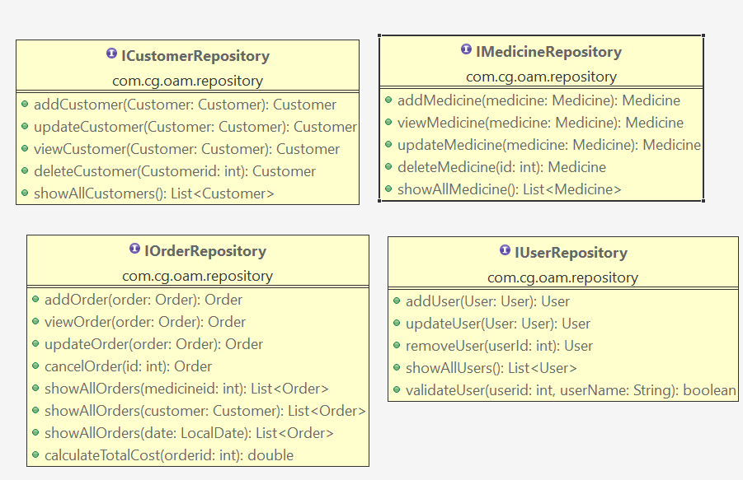
Class Design
Repository:

Slide 9




Questions

